Slide 1
Machine Learning and Music Composition
Machine Learning and Music Composition
Daniel Woeste
Division of Science and Mathematics
University of Minnesota Morris
2017-11-18
Dan

Slide 2
Introduction

Slide 3
Outline
Background
  Music
  Machine Learning
Methods
  Markov Chains
  Randoms Forests
  Neural Nets
Evaluation
Conclusion

Slide 4
Background
Background
  Music
Methods
Evaluation
Conclusion

Slide 5
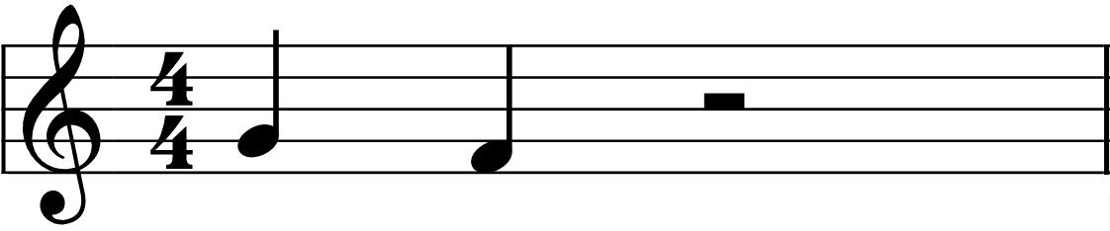
Melodic Progression
A melodic progress is the interval between two notes

Slide 6
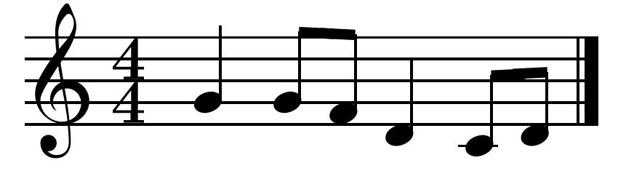
Melody
Combining several intervals together gives us a melody

Slide 7

Consonance Vs. Dissonance
Consonance
Multiple notes played together harmoniously
Dissonance
Chords that clash

Slide 8
Texture
Homophony
Single melodic line
May be accompanied or alone
Polyphony
Multiple melodic lines
All share equal importance

Slide 9
Background
Background
  Machine Learning
Methods
Evaluation
Conclusion

Slide 10
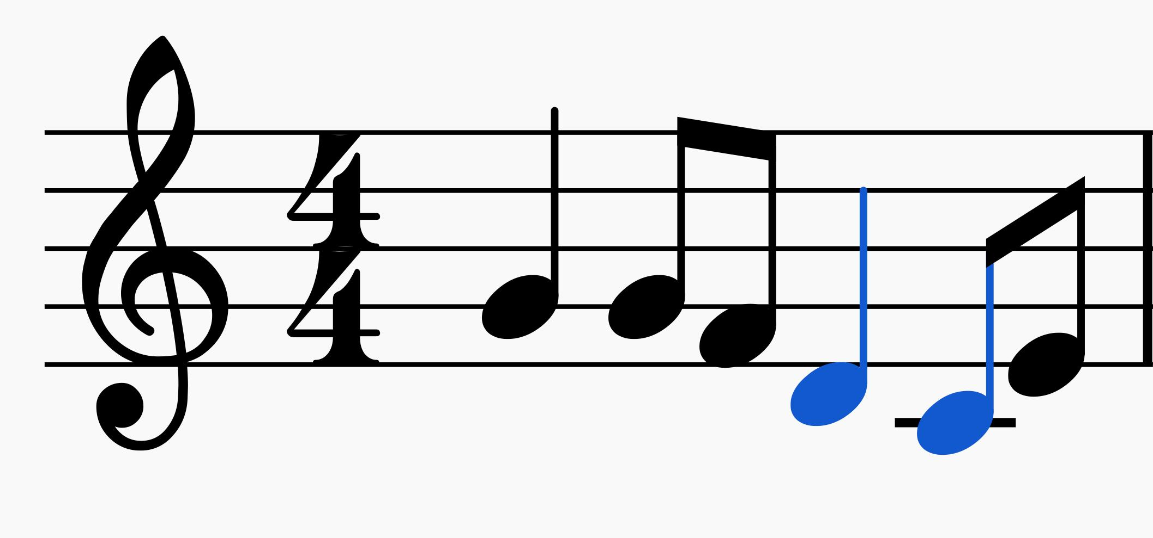
General Framework
All of the following methods share the a similar method of producing the next note
-Set of previous notes
-Key signature
-

Slide 11
Decision Trees
Branching tree like structure
  -Nodes represent choices
  -Branches represent the outcomes
Represents all tests and every possible outcome from the tests

Slide 12
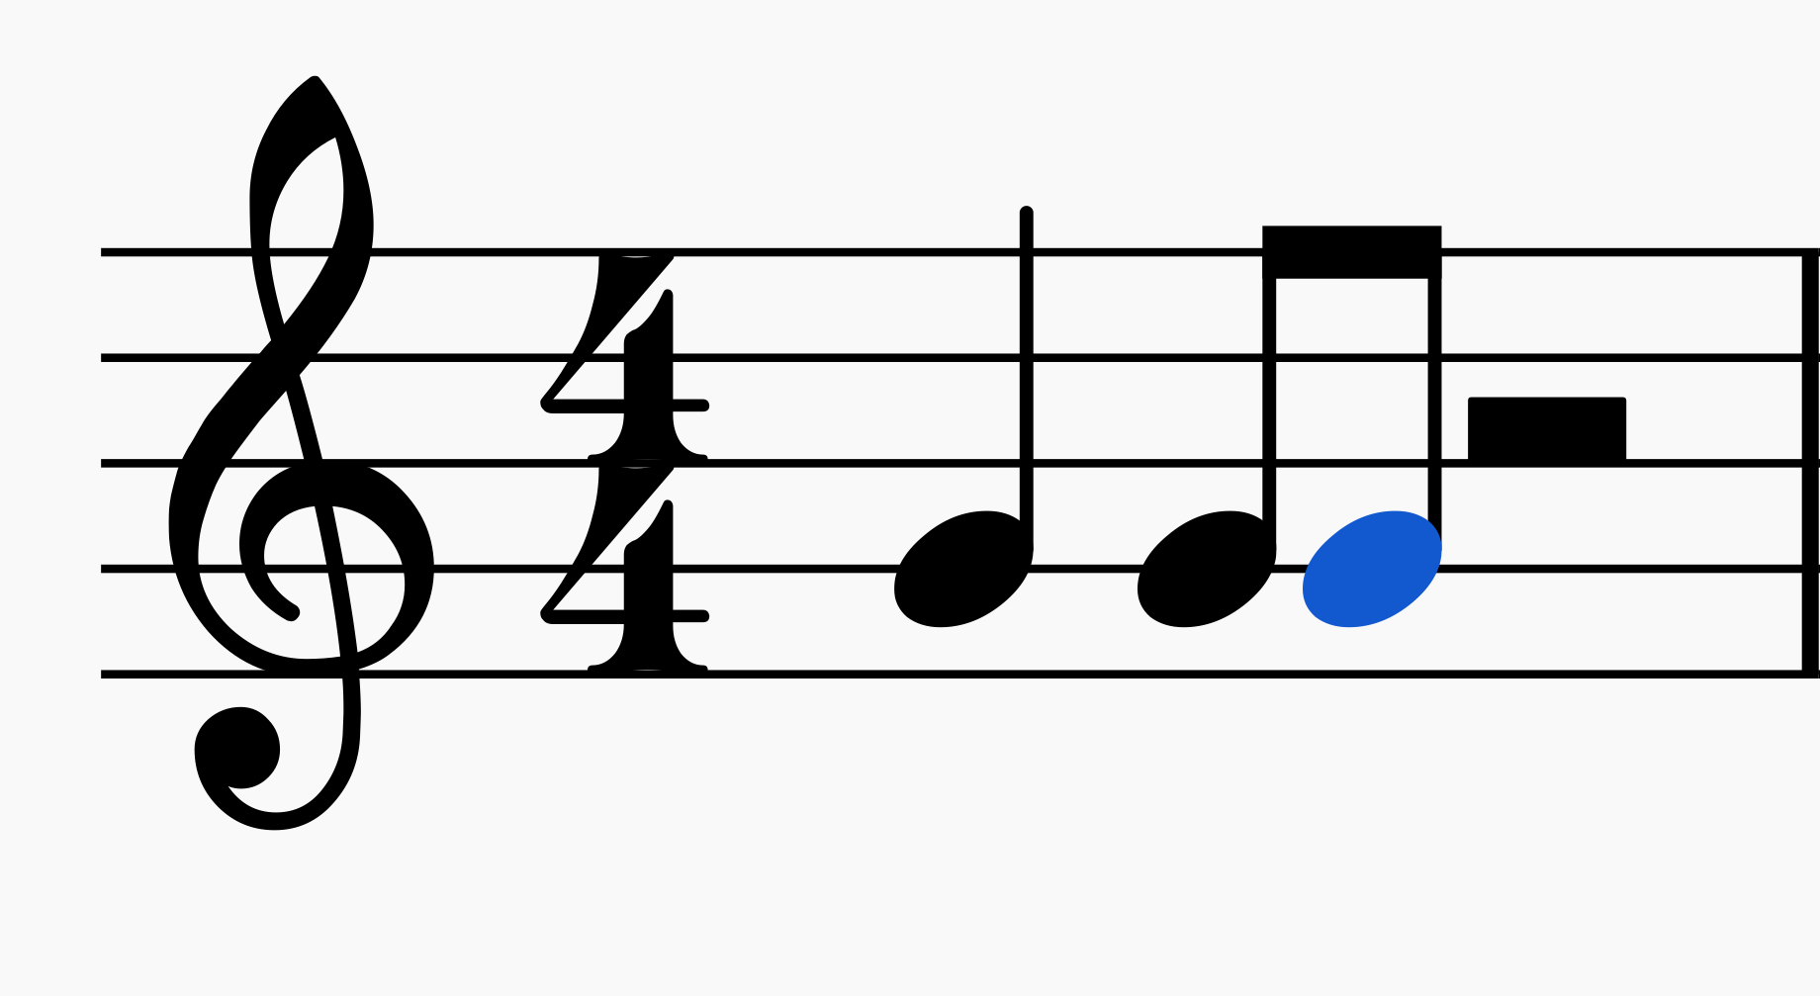
Key Signature C?
Eighth
Quarter

Slide 13
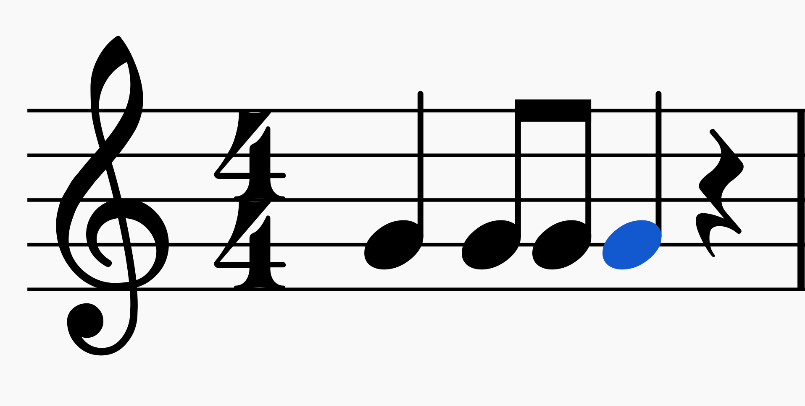
Key Signature C?
Eighth
Quarter
First note Eighth?
Eighth
Quarter

Slide 14
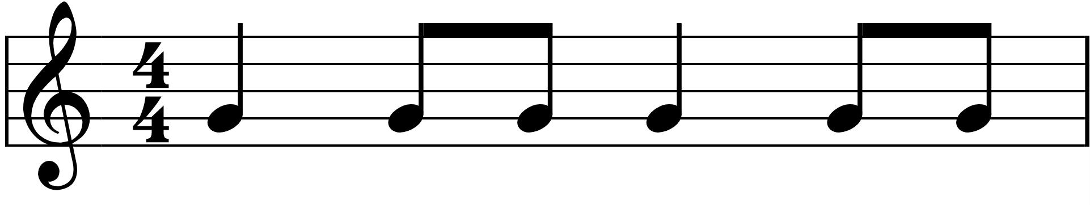
Key Signature C?
Eighth
Quarter
First note Eighth?
Eighth
Quarter
First Note Quarter?
Eighth
Quarter

Slide 15
Methods
Background
Methods
  Random Forests
Evaluation
Conclusion

Slide 16
Random Forests
A collection of decision trees makes a random forests
  -Training data split many ways
  -Final answer is the “most popular” vote

Slide 17
ALYISIA
Dual random forests
  -one for rhythm
  -one for pitch
Co-creative or autonomous process
Primarily used to recompose melodies for existing
songs

Slide 18
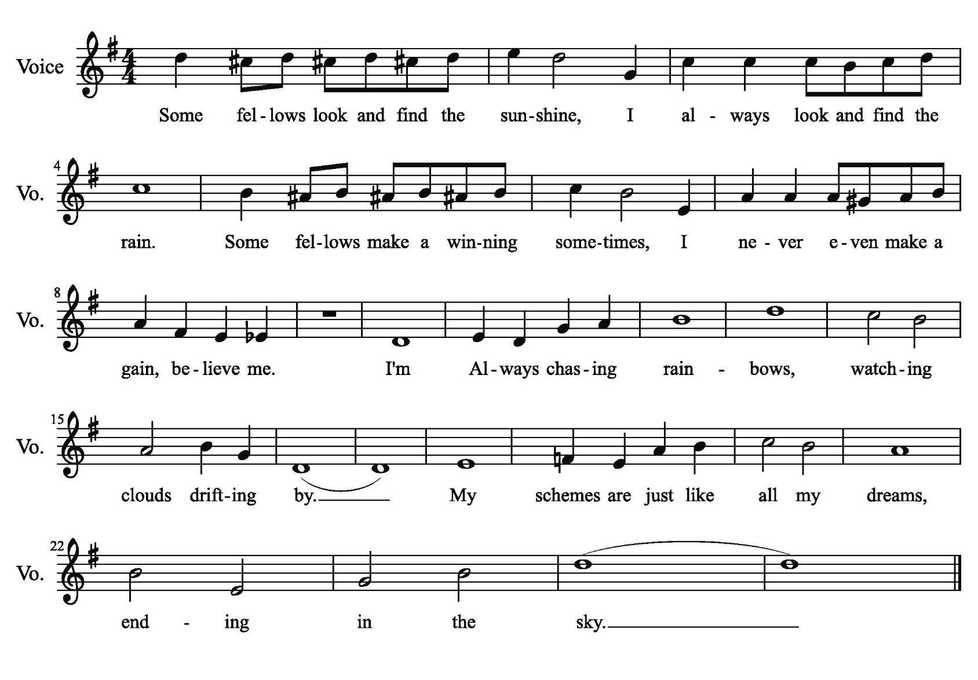
ALYISIA Music Example

Slide 19
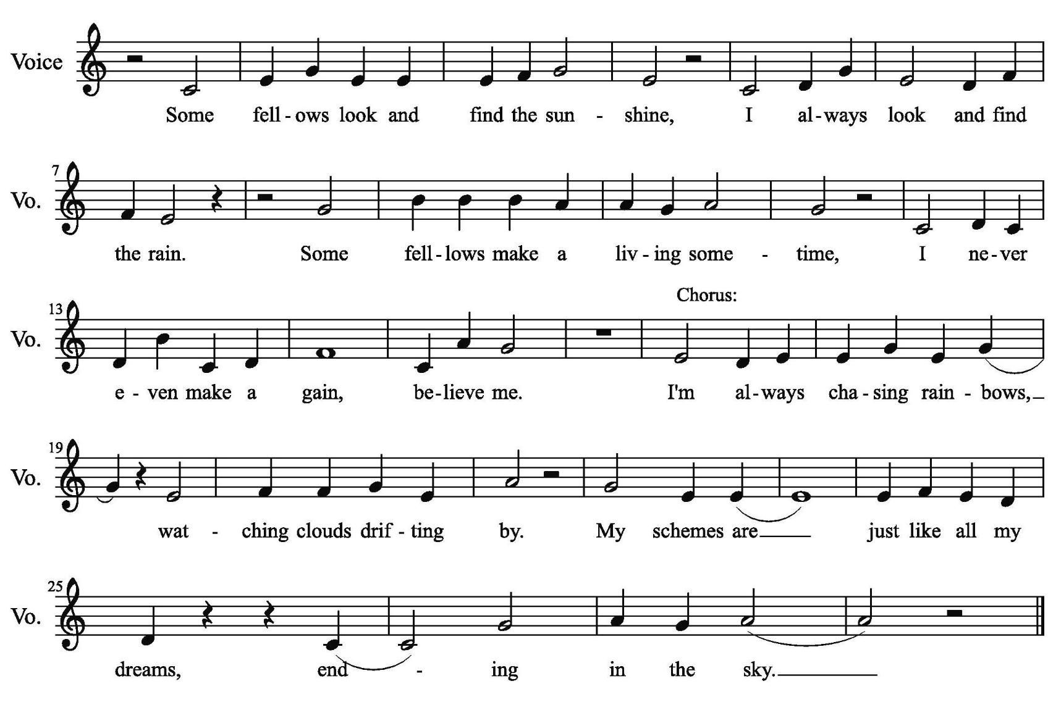
ALYSIA Music Example

Slide 20
Methods
Background
Methods
  Markov Chain
Evaluation
Conclusion

Slide 21
Markov Chains
Multi Chain method

Slide 22
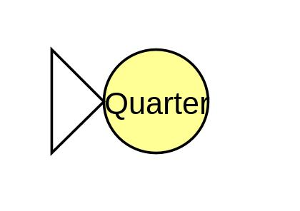
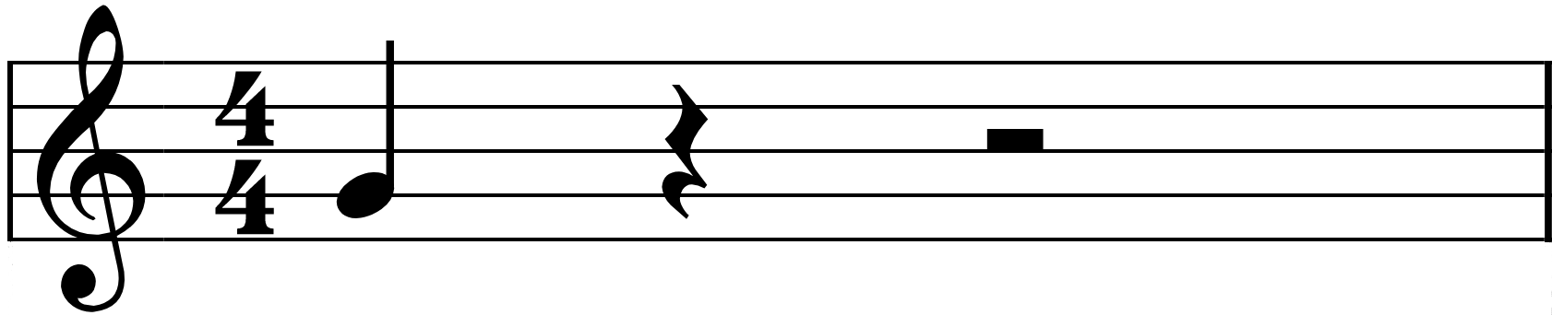
Markov Chains

Slide 23
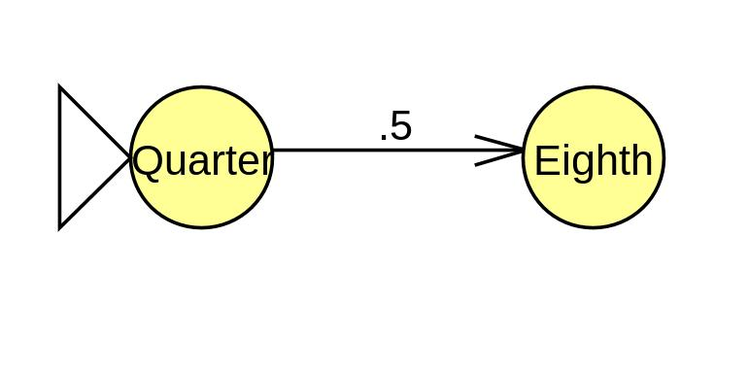
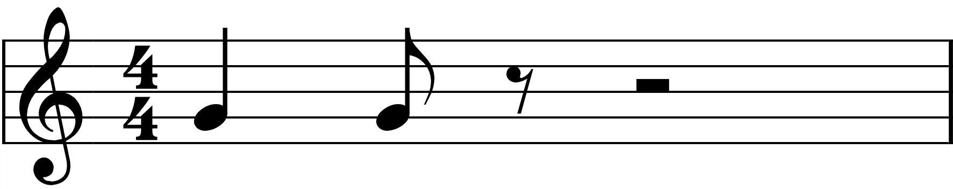
Markov Chains

Slide 24
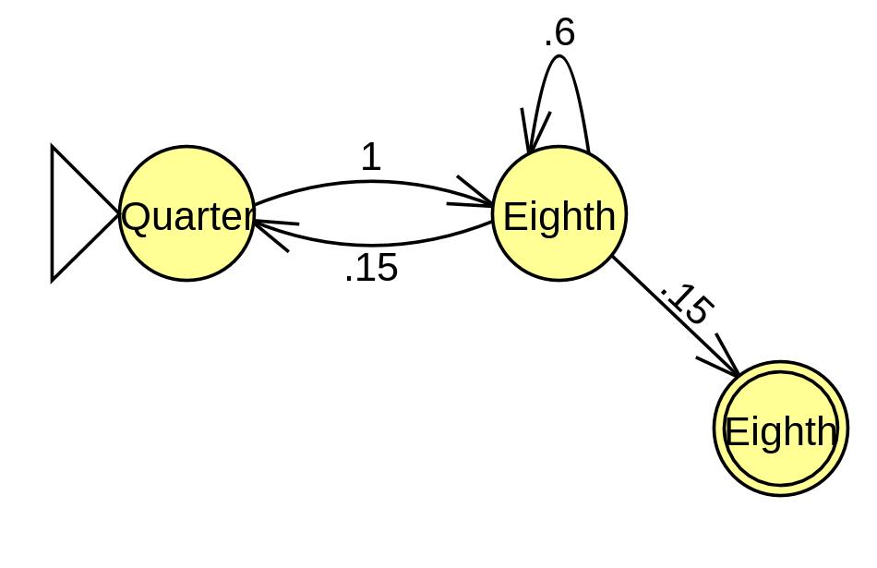

Markov Chains

Slide 25
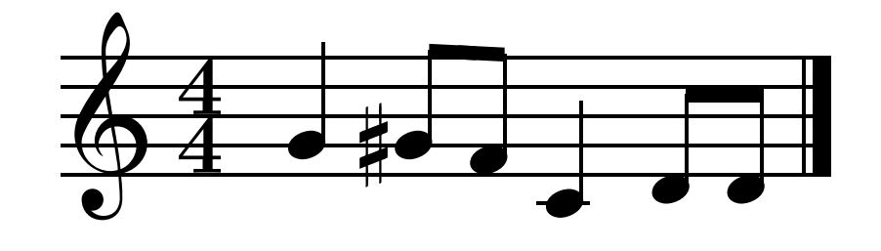
One-point mutation
Post processing on the written melody is done to make the music more complex
One-point mutation is an operation that traverses over the melody with a small percentage chance to change a note value.
Before
After

Slide 26
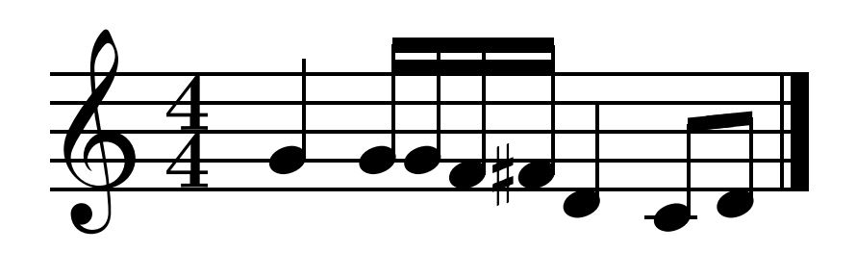
Note Splitting
Similar to one-point mutation
Duration instead of pitch

Slide 27
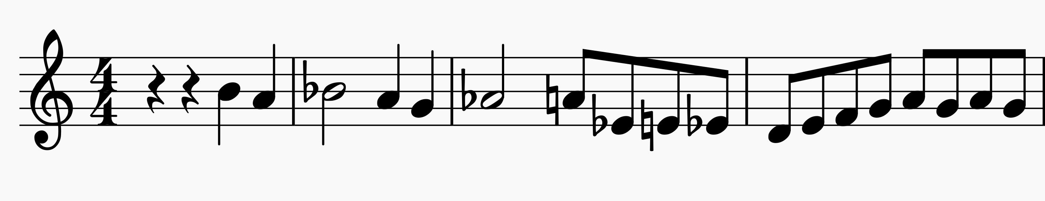
Markov chain example

Slide 28
Conclusion
Lack of musical direction

